Slide 1

MARKETING ANALYSIS OF STARBUCKS

Slide 2
TABLE OF CONTENTS
History and Background
Segmentation
Business Model
Discriminant Analysis
Executive Summary
Positioning
Data Summary
Recommendations

Slide 3
HISTORY AND BACKGROUND
Starbuck, largest multinational coffeehouse chain with an annual revenue of $33 Billion.
Founded by Jerry Balswin, Gordon Bowker, and Zev Siegl, in 1971
Started its operations at Seattle's iconic Pike Place Market, where it offered premium whole coffee beans, dark roasted in artisanal small batches.
Story behind the name
The name of Starbucks was chosen in honor of the coffee-loving first mate in Herman Melville's Moby Dick.
They thought the name evoked the romance of the high seas and the seafaring tradition of the early coffee traders.
The name of the store is encompassed by a twin-tailed siren from Greek mythology that serves as the company's current emblem.

Slide 4
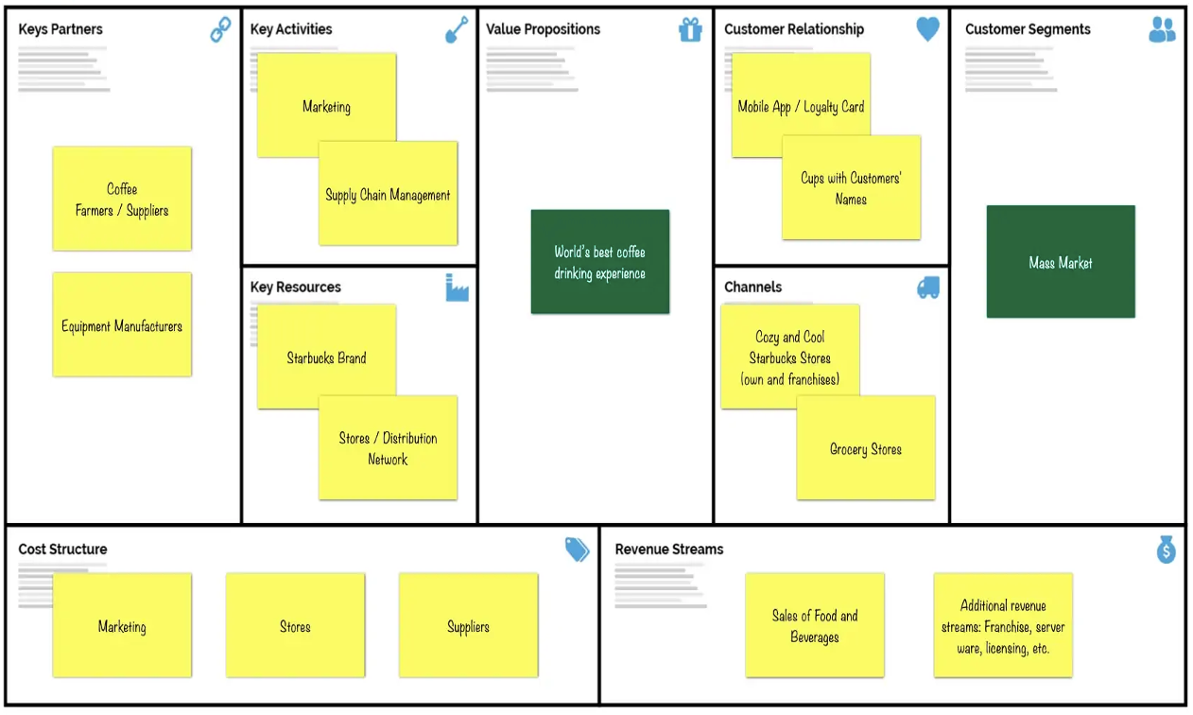
BUSINESS MODEL
Starbucks - Mission
Initially “Establish Starbucks as the premier purveyor of the finest coffee in the world while maintaining our uncompromising principles while we grow."
Now "To inspire and nurture the human spirit – One Person, One Cup , and One Neighborhood at a time."

Slide 5
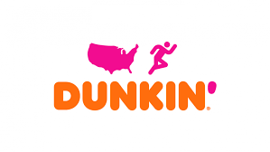


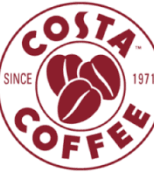

TOP COMPETITORS

Slide 6
EXECUTIVE SUMMARY
Nowadays, coffeehouse franchises have been introducing various marketing strategies, owing to increased demand and consumer preferences, which intensified the market competition. In an attempt identify the current market position of Starbucks and increase its market competitiveness, we conducted a survey to understand people’s perception of Starbucks and its competitors.
Goal of the report is to:
Outline people’s perception of Starbucks compared to its competitors.
Segment the market based on people’s perception and perform discriminant analysis
Identify the attributes influencing the customer’s perceptions in each segment
Identify Starbucks current positioning using perceptual maps and determine if a repositing strategy is required.
Suggest any general recommendation based on survey.
.

Slide 7
SURVEY QUESTIONS
Age (<20yrs, 20-35yrs, 35-60yrs, >60yrs)
Gender (Male, Female, prefer not to mention)
Ethnicity
Avg Income (<$20K, $20-$50K, $50-$100K, >$100K)
How often do you eat food outside?
Socialize with people?
Possess a Chase Credit card?
Follow magazines and tv commercials?
Discount coupons makes me think about the Franchise.
I like being tagged as a loyal customer

Slide 8
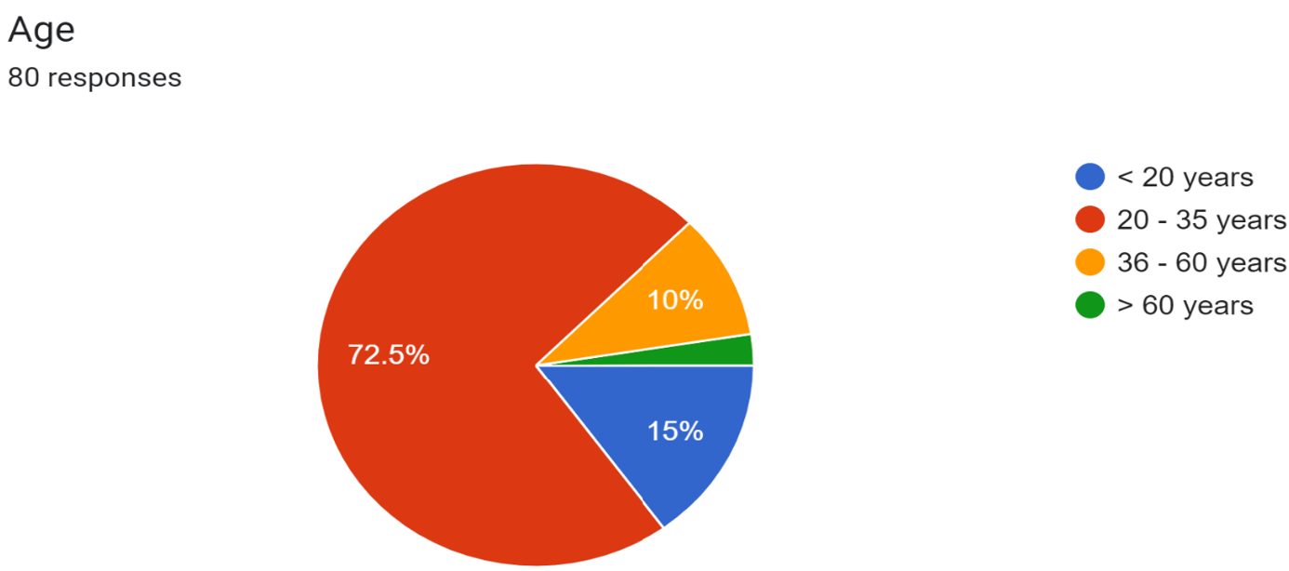
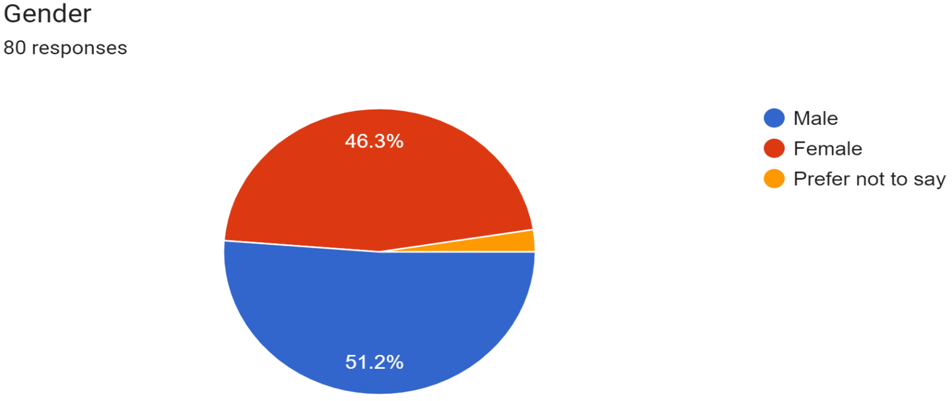
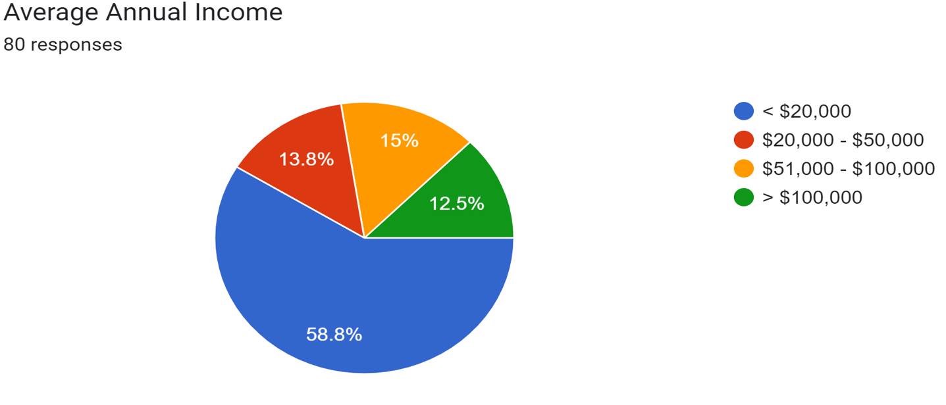
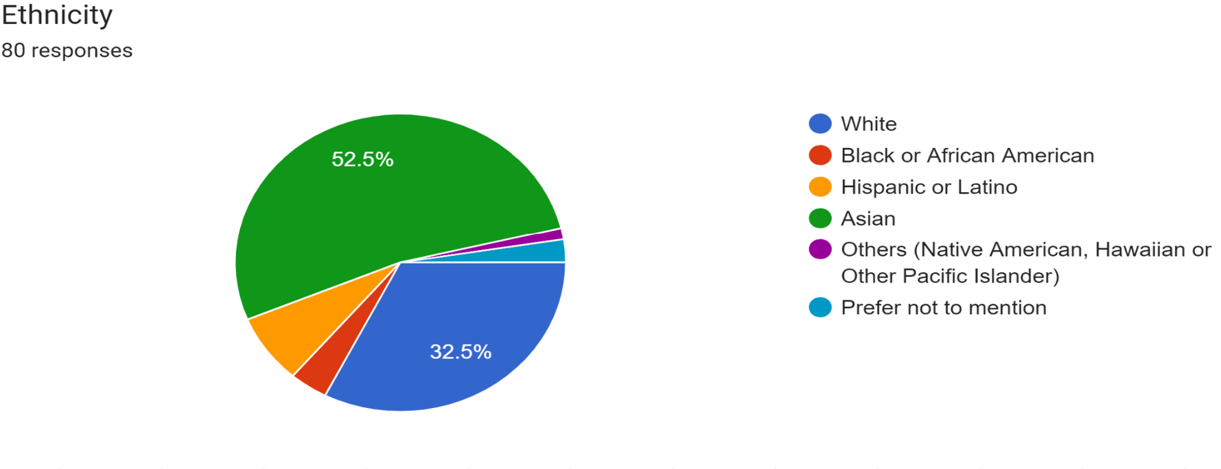
Data Summary

Slide 9
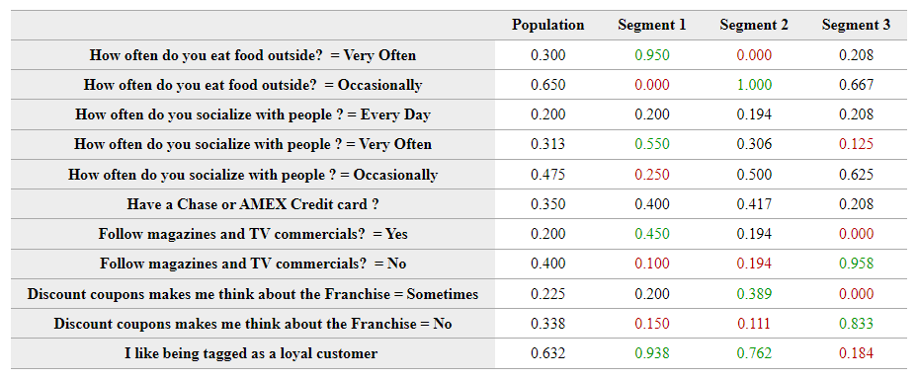
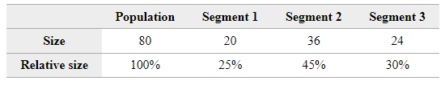
SEGMENTATION
Segment 1: Steadfast Customers
• Restaurant-goers who are most loyal and like socialize very often.
Segment 2: Incentivized Customers
• Occasional restaurant-goers who are influenced by discounts. Loyalty matters to them.
Segment 3: Torpid Customers
• Non loyal customers who are not influenced by discounts. These are Introverts who doesn't socialize.
Segment Size

Slide 10
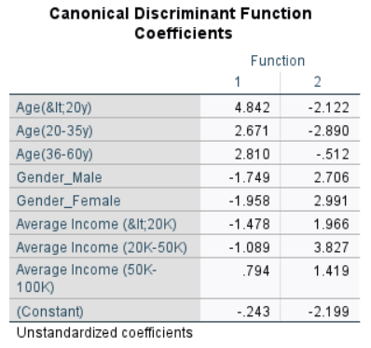
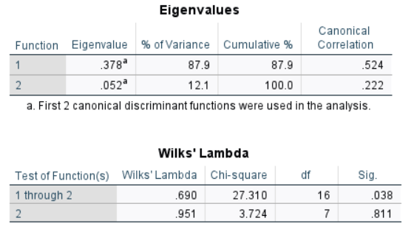
DISCRIMINANT ANALYSIS
• Performed discriminant analysis on demographic data collected from the survey - Age (dummy Coded), Gender (dummy Coded), Average Income (dummy Coded), using SPSS software.
• Excluded the Ethnicity factor from the discriminant analysis, as the ethnicity data is unbalanced in our survey responses.

Slide 11
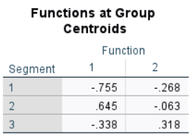
DISCRIMINANT ANALYSIS
Discriminant Function:
D = -0.243 + 4.842*Age(<20y)+ 2.671*Age(20-35y)+ 2.810*Age(36-60y) – 1.749*(Gender_Male) – 1.958*(Gender_Female) – 1.478*Average Income (<20K) – 1.089*Average Income (20K-50K) – 0.794*Average Income (50K-100K)
Cutoff Point calculation:
(0.645+0.755)/3 = 0.4666
First Cutoff Point: (0.645 – 0.4666) = 0.178
Second Cutoff Point: (0.178 – 0.466)= - 0.288
Therefore, if D > 0.178 then potential respondent falls in segment 2, and when -0.288<D< 0.178 then potential respondent falls in segment 3, and when D < -0.288 then potential respondent falls in segment 1

Slide 12
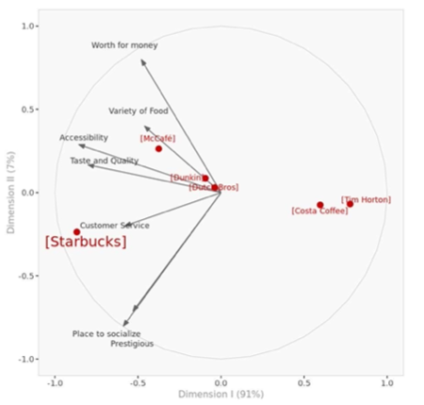
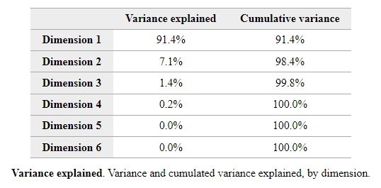
POSITIONING ANALYSIS
Dimensions I-II incorporate 98.5% of the total variability in the data. So, we limit our analysis to 2 dimension.
People’s Perception of Starbucks
Perceived as a prestigious brand with a good customer service and a great place to socialize.
It more accessible and has a good variety of food, with great taste and quality.
Not worth for money, compared to McCafé

Slide 13
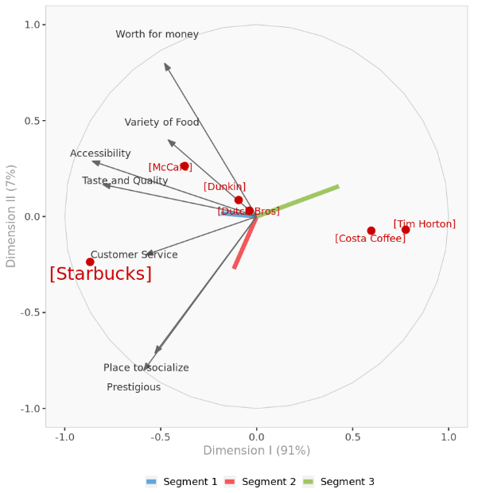
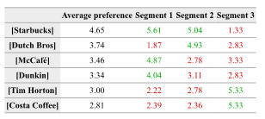
INFLUENTIAL ATTRIBUTES IN EACH SEGEMENT
Segment I: Accessibility, Taste and Quality, Customer service.
Segment II: Place to Socialize, Prestigious.
Segment III: Worth for money (but not very influential)

Slide 14

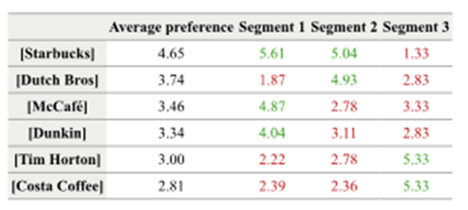
REPOSITIONING STARBUCKS
Starbucks should be marketed to segment 1 and segment 2, and avoid segment 3
Starbucks outperforms on all the attributes (expect worth for money) compared to its competitors.
So, it a repositioning strategy. However, it should introduce more variety of foods to avoid any competition from McCafé in terms of variety of foods .
doesn’t need

Slide 15
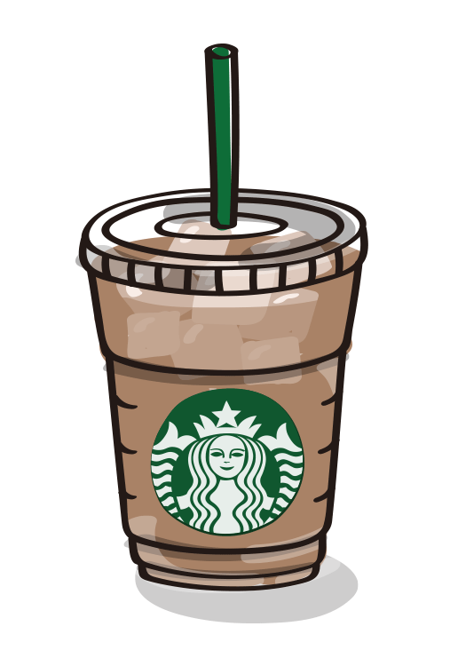
RECOMMENDATIONS
Starbucks should start a marketing campaign to introduce a variety food to attract more customers.
Starbucks has high potential to emerge in untapped markets by tailoring menu according to the local taste.
Expanding in the market of packaged coffee and iced beverage.
Obtain premium shelf space and boost the effectiveness of this distribution channel, Starbucks needs to develop stronger partnerships with big box retailers.

Slide 16


